Slide 1
SlotWise AI
PRESENTED BY:
Akhilesh Patil

Slide 2
Introduction & Project Objectives
Decides where every SKU should be stored, and explains why
Objectives:
  Reproducible warehouse data
  Constraint-safe, explainable slot assignment
  Measurable picking and replenishment impact
  Exception detection with a full audit trail
  REST API + interactive dashboard
  ML forecasting + grounded AI assistant

Slide 3
Problem Statement & Proposed Solution
Thousands of SKUs across zones and facilities Poor placement leads to: Long pick paths and slow fulfillment Wasted capacity and frequent replenishment Unsafe storage (flammable + oxidizer, food + chemicals) Blocked routes and higher labor cost Decisions are usually manual and unexplained | Profile demand: velocity, ABC/XYZ, reorder point Filter candidate slots with hard constraints (size, weight, temperature, hazard, policy) Rank with an explainable six-factor score Solve the assignment with OR-Tools CP-SAT Approve via governed workflow; history never overwritten Measure impact on identical orders

Slide 4
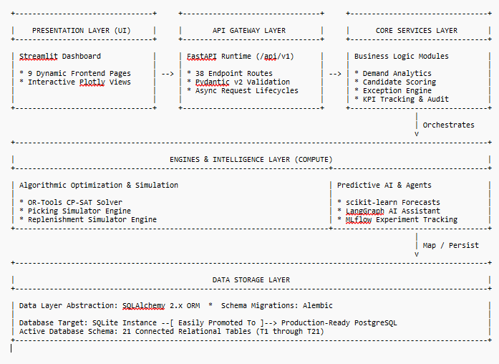
System Architecture & Technologies Used

Slide 5
Technologies:
Python 3.12 · FastAPI · SQLAlchemy · Alembic · Pandas/NumPy
· Pandera · OR-Tools · scikit-learn · MLflow · LangGraph
· Streamlit · Plotly · Pytest · Ruff · Docker · GitHub Actions

Slide 6
Key Features & Functionalities
Deterministic data: 3 profiles, 21 labelled anomalies, SHA-256 reproducibility
18-rule validation: PK/FK, physical limits, arithmetic, ground-truth isolation
Explainable slotting: 6 sub-scores stored per candidate; rejected slots keep their reasons
Governed lifecycle: PROPOSED → ACTIVE → SUPERSEDED, versioned and audited
Pick-path optimization: blocked aisles avoided; baseline vs. optimized on the same orders
Replenishment simulation: reorder-point tasks vs. daily labor capacity
Exception center: 7 issue types, severity triage, auto-resolution
AI layer: demand forecasts in MLflow + grounded assistant with no-API-key fallback

Slide 7
Results table
Metric | Baseline | Optimized
Pick distance (497 identical orders) | 67,608 m | 51,893 m (−23.2%)
Pick time | 22.0 h | 18.1 h (−17.7%)
Hard-constraint violations | 10 | 0
Average assignment score | 0.646 | 0.745 (+15.3%)
Exceptions detected vs. ground truth | — | 21/21, F1 = 1.0

Slide 8
Conclusion
Complete, reproducible, explainable slotting platform on one shared data model
23% shorter pick paths with zero constraint violations
Every decision traceable; history never overwritten
AI used safely: optional, grounded and fully functional without an API key

Slide 9
Future Scope
Live WMS/ERP and scanner telemetry integration
Seasonal / forecast-triggered dynamic re-slotting
Joint picking + replenishment labor optimization
3-D bin packing with rotation
Multi-warehouse balancing and transfers
Intermittent-demand forecasting (Croston/TSB) and promotion signals
PostgreSQL scale-out and role-based access control

